Slide 1
Adversarial ML

Slide 2
Grading
Many have some issues with the peer review forms. To address these, there is a channel on Mattermost:
Lab grading issues
Please post issues there, we take them seriously and if we agree that the rubric question is not good, we will either leave out that part, or assign full points
We understand that times are stressful and a lot of lab work is asked of you, we decided to lower the requirement for the final lab from the planned 35 points to 25 points, removing the individual components. The final lab will be released the end of this week.
Gading the first assignment has finished and will be online today.

Slide 3
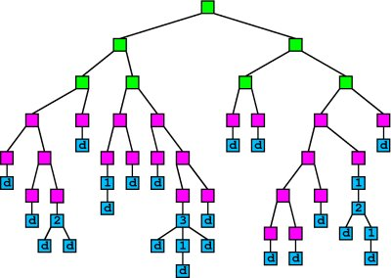
Learning from streams

Slide 4
General idea
Many ML algorithms are greedy and use data to estimate statistics
For every greedy step:
Wait till sufficient data is available
use sampling, hashing, sketching if possible
Compute statistics with high certainty
Perform greedy steps with high certainty

Slide 5
Sufficient statistics
“no other statistic that can be calculated from the same sample provides any additional information as to the value of the parameter”
For example, the sample mean is a sufficient statistics for the expected value of normally distributed data
For Decision Trees, we need e.g. GINI index:
G() = 2 * (n+ / n) * (n- / n)
i.e., estimates of n, n+, and n-

Slide 6
Data Mining As Search
Training Data
Training Data
Training Data
1.8
1.7
...
1.9
...
1.5
1.9
2.0

Slide 7
How Much Data is Enough?
Training Data
X1?
1.65
...
1.38
Xd?

Slide 8
How Much Data is Enough?
Sample of Data
Use statistical bounds
Normal distribution
Hoeffding bound
Applies to scores that are average over examples
Can select a winner if
Score1 > Score2 + ε
How to determine ε?
1.6 +/- ε
X1?
...
1.4 +/- ε
Xd?

Slide 9
How Much Data?
Make sure best attribute is better than second
That is:
G is the estimated Gini
Using a statistical result: Hoeffding bound
Collect n data point untill:
Then, X1 is correct with probability 1-δ, distribution-free!
With R the range (log c, where c is the number of classes)

Slide 10
Hoeffding Tree Algorithm
Procedure HoeffdingTree(Stream, δ)
Let HT = Tree with single leaf (root)
Initialize sufficient statistics at root
For each example (X, y) in Stream
Sort (X, y) to leaf using HT
Update sufficient statistics at leaf
Compute G for each attribute
If G(best) – G(2nd best) > ε, then
Split leaf on best attribute
For each branch
Start new leaf, init sufficient statistics
Return HT

Slide 11
VFDT (Very Fast Decision Tree)
Memory management
Memory dominated by sufficient statistics
Deactivate less promising leaves/attributes when needed
Ties:
Wasteful to decide between identical attributes
Check for splits periodically
Postpone time-consuming tasks!
Pre-pruning (optional)
Consider not splitting as option
Only make splits that improve the value of G()
Initialize with model from traditional learner
Rescan old data when time available
avoid bad decisions due to observing examples once

Slide 12
Practical learning from streams
Prove that given infinite data, the result is the same as the batch-version with high probability
Define sufficient statistics
Estimate using sketches/hashes/samples
Store incoming data in buffer as long as possible
Use to re-estimate if time permits, clearly better estimates than proven…
Postpone expensive operations
Clearly not log(n), postpone exponentially to get log(n) time on average…
Pick most promising step when there is insufficient information to guarantee correctness…

Slide 13
Practical learning from streams
Prove that given infinite data, the result is the same as the batch-version with high probability
Define sufficient statistics
Estimate using sketches/hashes/samples
Store incoming data in buffer as long as possible
Use to re-estimate if time permits, clearly better estimates than proven…
Postpone expensive operations
Clearly not log(n), postpone exponentially to get log(n) time on average…
Pick most promising step when there is insufficient information to guarantee correctness…
Stream learning theory imposes constraints that can be avoided in practice!

Slide 14
Adversarial ML

Slide 15
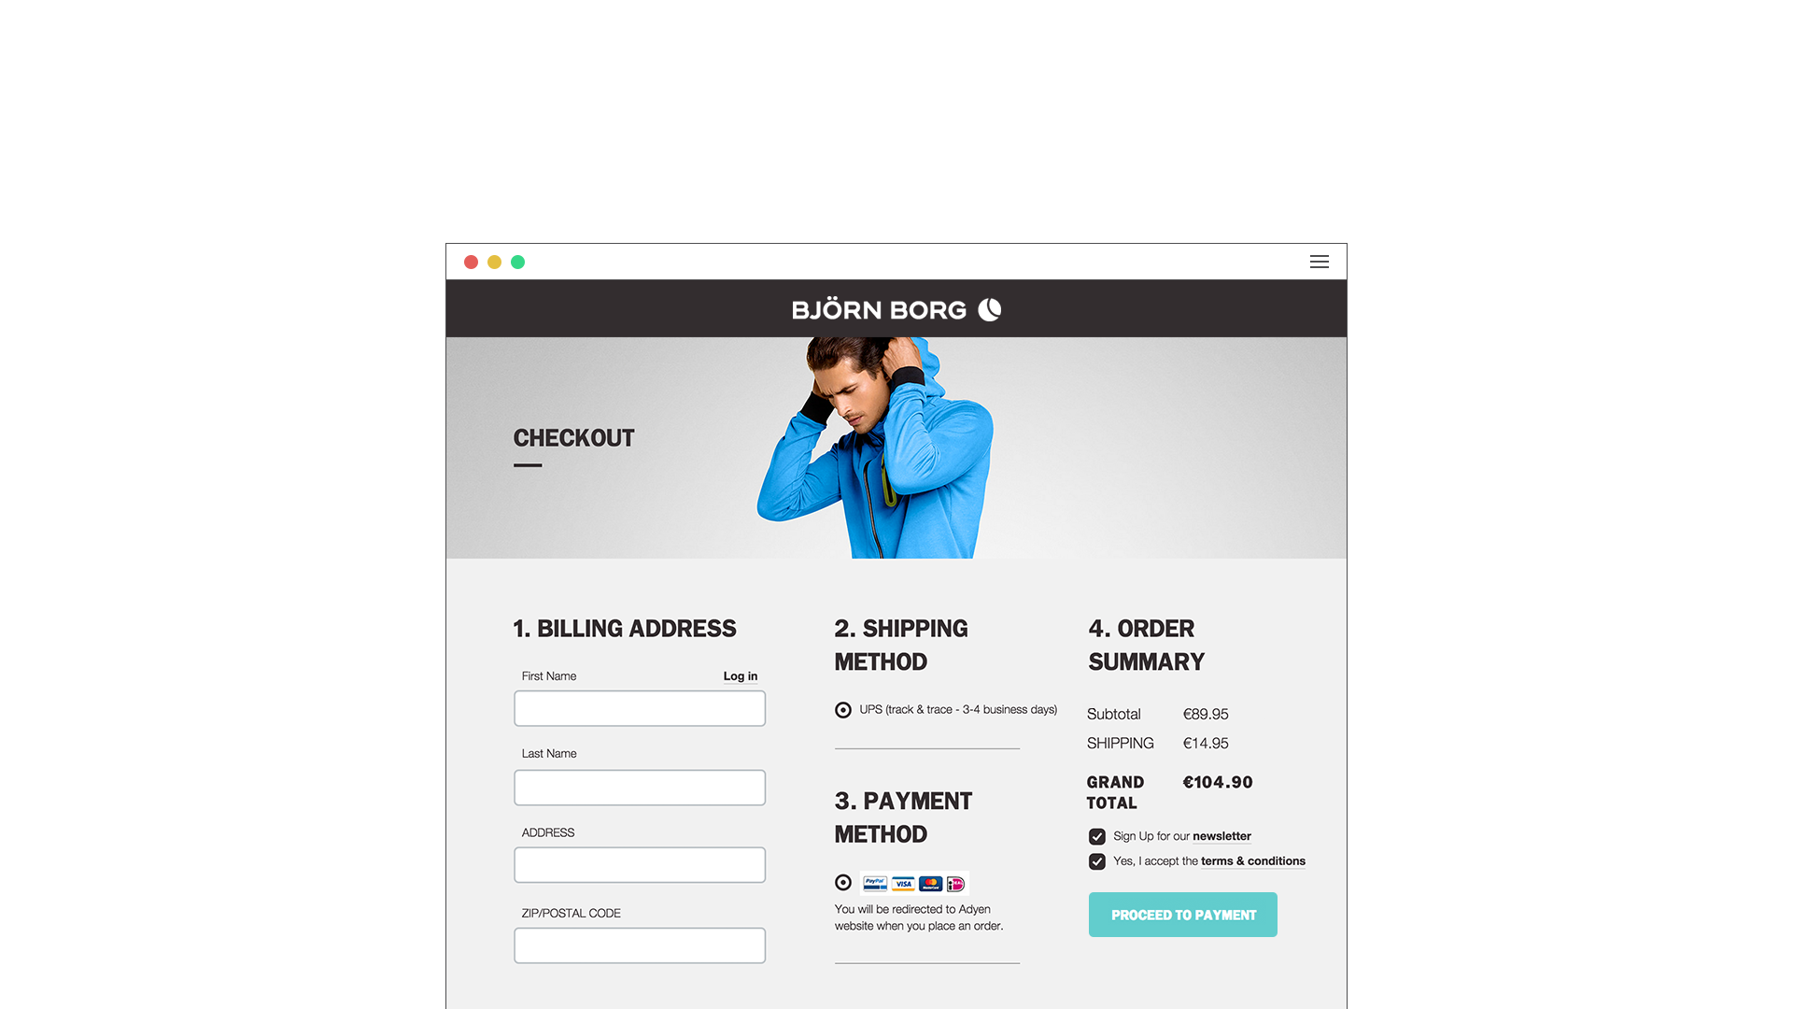

How would you commit fraud?

Slide 16
How would you commit fraud?
You will need:
a lot of different stolen credit cards
stay anonymous

Slide 17
How would you stop fraud?

Slide 18
How would you stop fraud?
Ideas:
detect the use of many different credit cards
high velocity of details
proxy IP detection

Slide 19
How would you commit fraud?

Slide 20
How would you commit fraud?
You will need:
to change details all the time
to behave as normal as possible

Slide 21
How would you stop fraud?

Slide 22
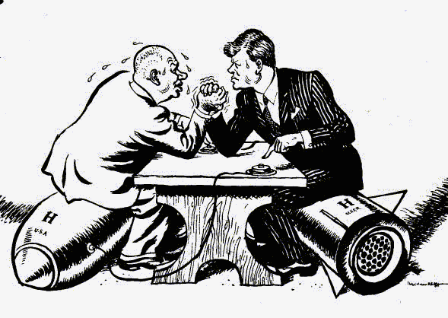
How would you stop fraud?

Slide 23
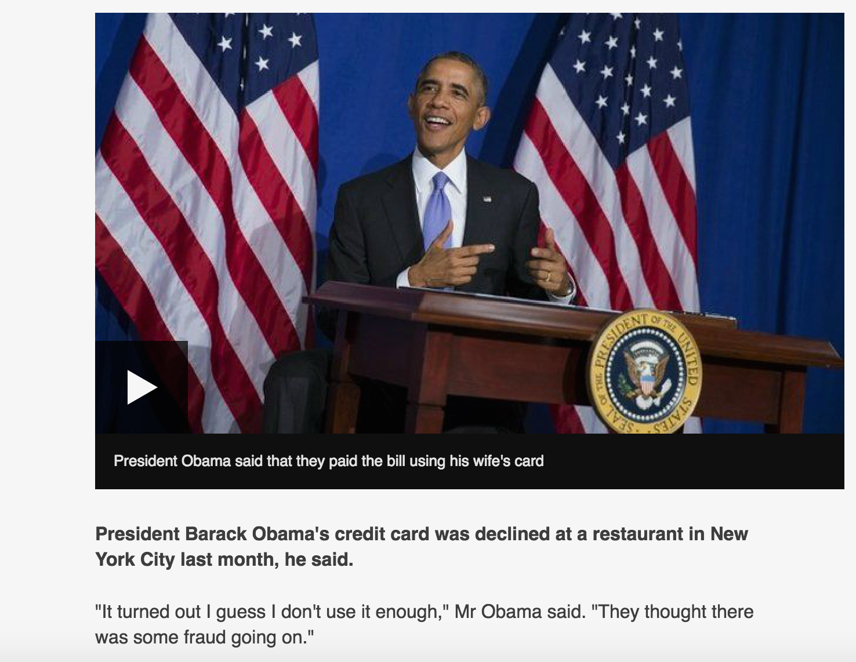
How would you stop fraud?

Slide 24
ML Systems are in an Arms Race
ML systems are never deploy-and-forget
Malicious users can always attack the purpose of your system
You update your system according to the latest undetected patterns

Slide 25
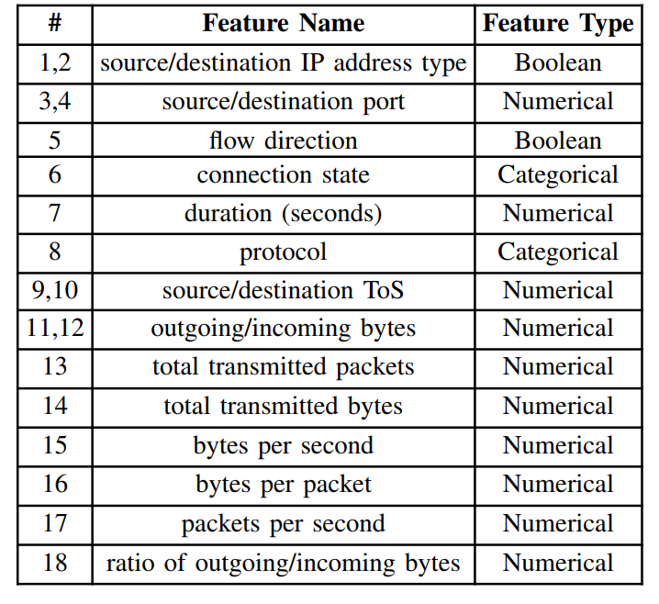
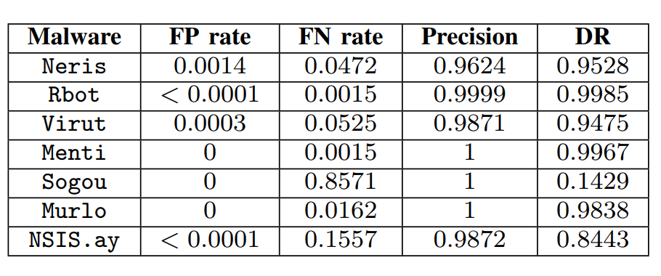
Random Forest on CTU13

Slide 26
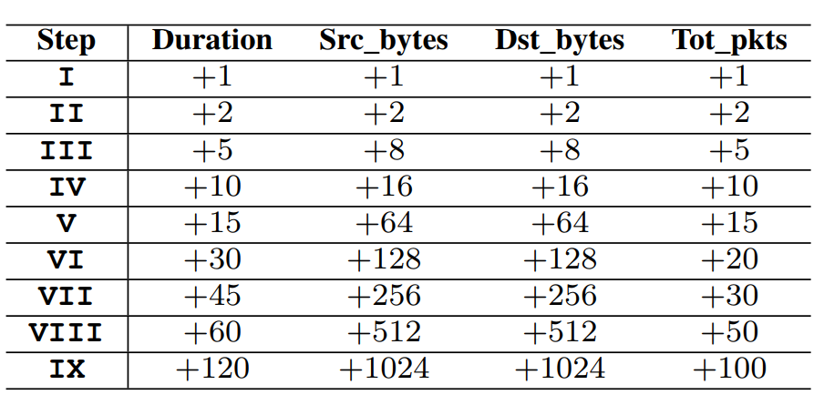
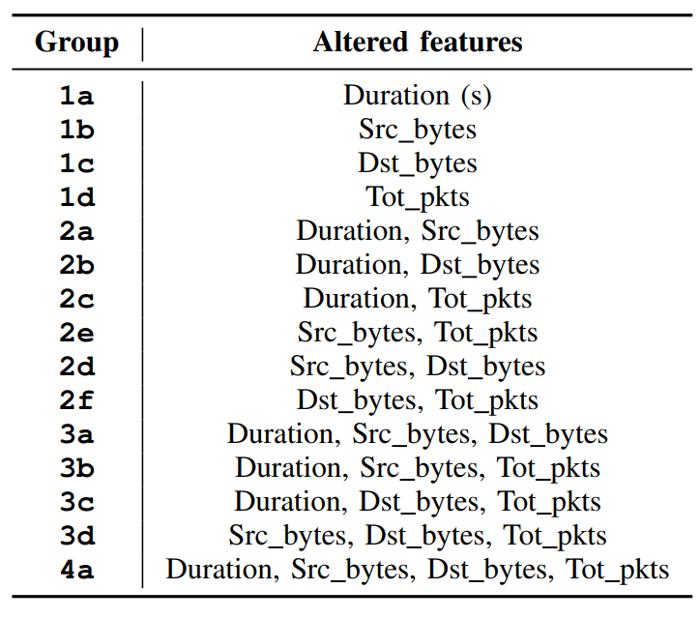
Random Forest on CTU13

Slide 27
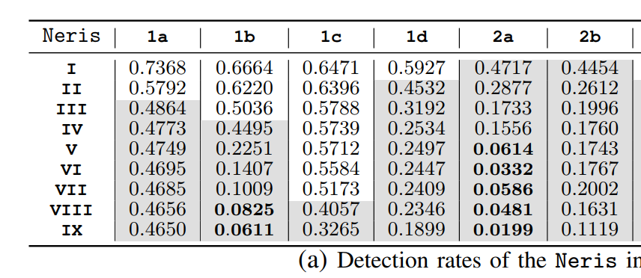
Random Forest on CTU13
Apruzzese, G., & Colajanni, M. (2018). Evading Botnet Detectors Based on Flows and Random Forest with Adversarial Samples. 2018 doi:10.1109/nca.2018.8548327

Slide 28
What is happening?
Small changes in features have disastrous effects on detection rates

Slide 29
What is happening?
Small changes in features have disastrous effects on detection rates

Slide 30
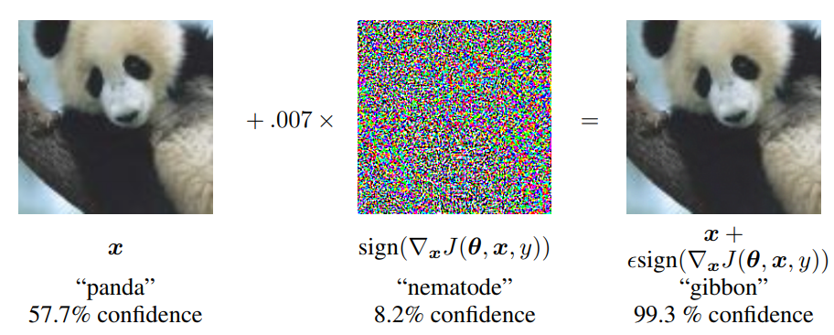
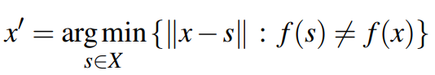
Finding adversarial examples
f mis-classifies a modified x generally
f classifies a modified x as a given target class yt
Explaining and Harnessing Adversarial Examples
Ian J. Goodfellow, Jonathon Shlens, Christian Szegedy
https://arxiv.org/abs/1412.6572

Slide 31
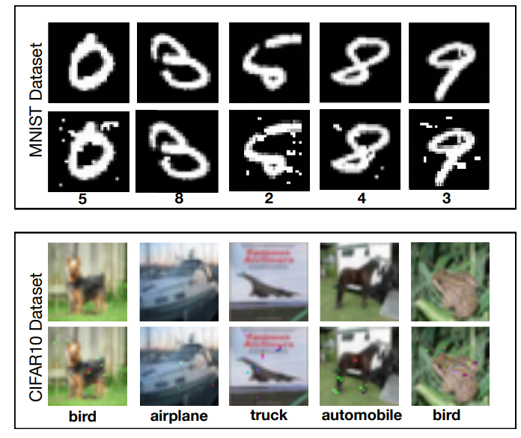
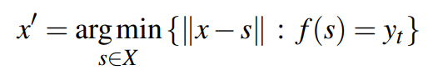
Finding adversarial examples

Slide 32
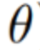
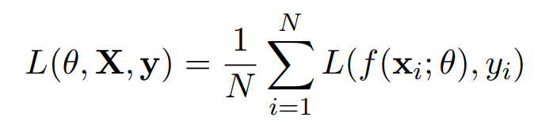
Taking a step back: ML Systems
In CDA, we build classifiers that minimize empirical risk, i.e. for
data x with label y from distribution D
our classifier f parameterized by makes the fewest mistakes as measured by a loss L
e.g. for classification with a 0-1 loss

Slide 33
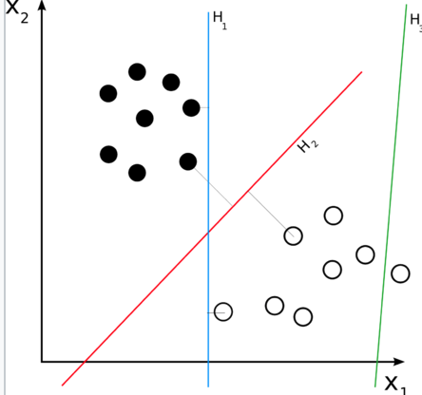
Taking a step back: ML Systems

Slide 34
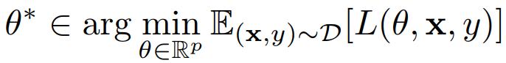
Taking a step back
Empirical risk (as seen in training) approximates risk on real distribution
therefore learning the parameters that minimize it give a good model

Slide 35
Finding adversarial examples
Given an f minimizing the risk, and a starting point x
f mis-classifies
f classifies as desired target class t

Slide 36
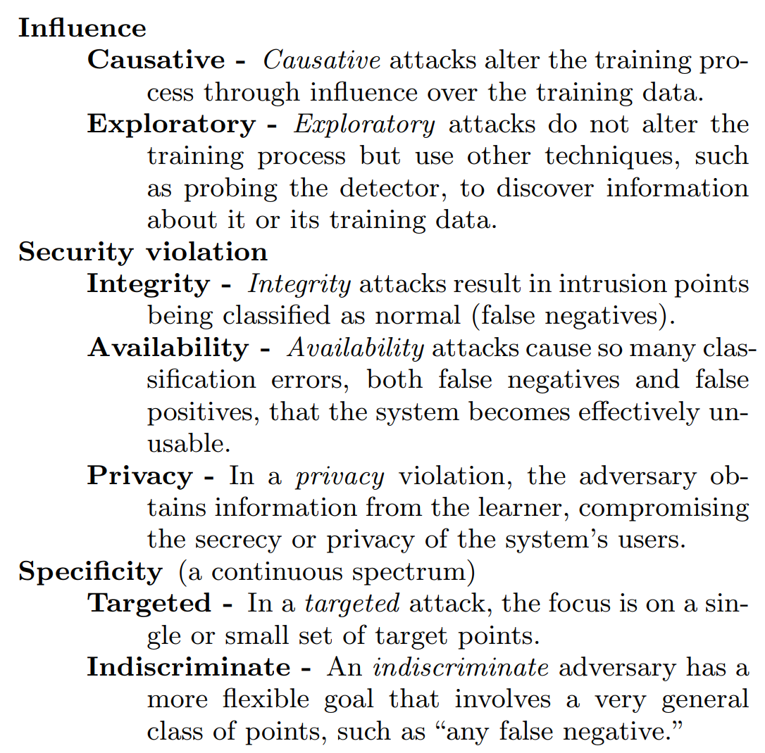
Different attacks
poisoning attack at training time
adversarial samples at deployment
Huang et al
Adversarial Machine Learning

Slide 37
ML Systems are in an Arms Race
Build the right model for the correct task
Need to continuously update models
Attackers will attack the purpose of your model
Yet, there is another class of attacks:
attacking the model itself

Slide 38
ML Arms race
Example: beating the spam filter
Spam filters on normal emails
Indicative words: cheap, sale, now
Spammers use intentional misspellings
Indicative words change: cheep, sal3, n0w
iterative process!

Slide 39
Application to CDA
There are often restrictions, such as
semantic constraints: preserve function/meaning of sample
cost of modifications
threat model
Example: Malware classification
Extract system calls from binaries
Use binary “call used”/”call not used” vector

Slide 40
The data – Lab 4

Slide 41
The problem
find a model that minimizes expected loss
loss can be the error count/accuracy

Slide 42
But malware will be modified…
…by adding system calls
this can be done without changing its behavior

Slide 43
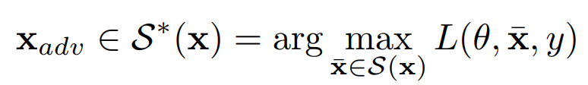
Attacking a Neural Net
simply maximize:

Slide 44
Attacking a Neural Net
Note the difference:
simply maximize:

Slide 45
Evasion rates
dFGSM^{k} = deterministic Fast Gradient Sign Method

Slide 46
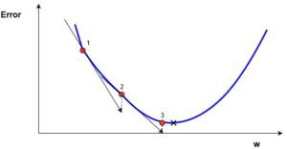
Fast Gradient Sign Method
iteratively update:
a form of gradient descend/ascend

Slide 47
The real problem: defense
find a model that minimizes expected loss
loss can be the error count
subject to adversarial modifications

Slide 48
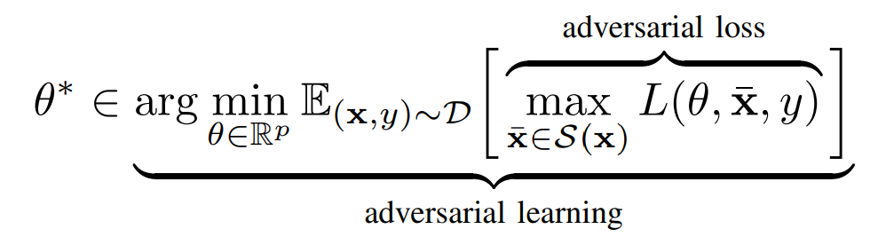
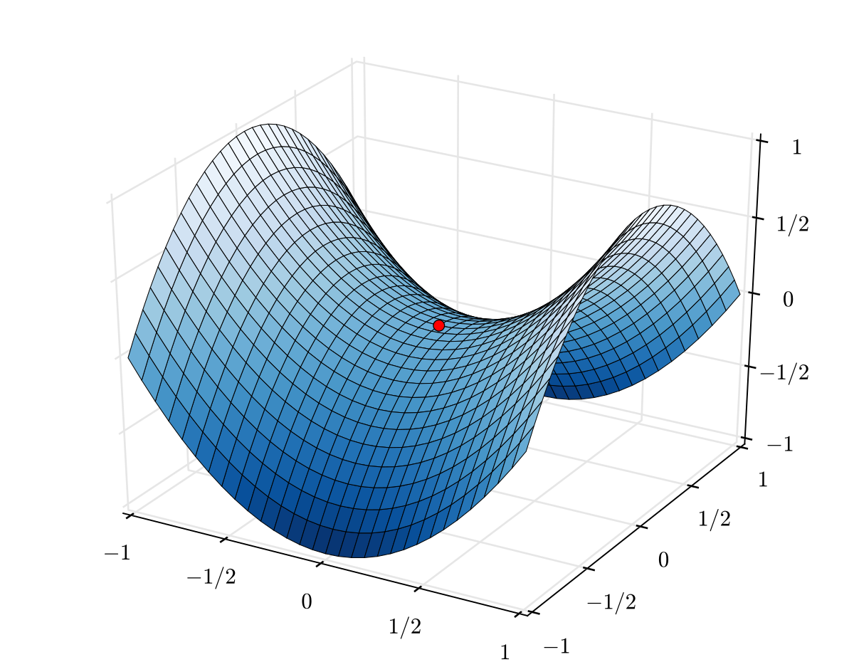
A min-max optimization problem
aka saddle point optimization

Slide 49
Hardening
at least, that is the intuition

Slide 50
Hardening

Slide 51
Hardening
in practice
in practice there is a lot of empty space to target

Slide 52
Hardening
in practice
in practice there is a lot of empty space to target

Slide 53
Hardening
A fancy way to perform
anomaly detection
in practice
in practice there is a lot of empty space to target

Slide 54
Evasion rates vs hardened models

Slide 55
The goal - build a good inner maximizer

Slide 56
The goal - build a good inner maximizer
Risk of overtraining on the Benign data, but this may be good for anomaly detection

Slide 57
Summary
Machine learning systems are vulnerable
Before learning (poisoning)
During model deployment (adversarial)
Robustness of models can be improved
by using adversarial samples during training

Slide 58
Attacks in practice

Slide 59
Attacks in practice

Slide 60
Gradient

Slide 61
Constraints
Gradient

Slide 62
Integer
Constraints
Gradient
1. Only gradient information
2. May point to local optimum
3. Does not respect constraints
4. Bad approximation for nearby integer solutions

Slide 63
Integer
Constraints
Gradient
1. Only gradient information
2. May point to local optimum
3. Does not respect constraints
4. Bad approximation for nearby integer solutions
5. Have to find good solutions fast for defence

Slide 64
GRAMS – an algorithm we designed that
Greedy – follows the gradient
Random – is stochastic
Adaptive – slow when difficult, fast when easy
Multibit – flips multiple bits
Search – …, well, it does hill-climbing

Slide 65
Greedy
Given a batch of data points
We perform bitflips, which ones to flip?
0 | 0 | 1 | 1 | 0 | 1 | 0 | 0
0 | 1 | 0 | 0 | 1 | 0 | 1 | 1
0 | 0 | 1 | 0 | 1 | 1 | 1 | 1
0 | 1 | 0 | 1 | 1 | 0 | 0 | 0

Slide 66
Greedy
Given a batch of data points
We perform bitflips, which ones to flip?
Let’s compute the gradient:
0 | 0 | 1 | 1 | 0 | 1 | 0 | 0
0 | 1 | 0 | 0 | 1 | 0 | 1 | 1
0 | 0 | 1 | 0 | 1 | 1 | 1 | 1
0 | 1 | 0 | 1 | 1 | 0 | 0 | 0
0.5 | -0.5 | 0.0 | -1.3 | 1.5 | -0.6 | 0.3 | 0.4
0.2 | -0.9 | 0.1 | 0.1 | 1.2 | 0.4 | -0.4 | -0.2
-1.2 | 0.5 | -0.3 | 0.7 | -1.4 | -0.2 | 0.4 | 0.2
0.8 | -0.2 | 0.8 | -0.3 | 0.2 | 0.5 | -0.1 | 0.0

Slide 67
Greedy
Given a batch of data points
We perform bitflips, which ones to flip?
Let’s compute the gradient:
0 | 0 | 1 | 1 | 0 | 1 | 0 | 0
0 | 1 | 0 | 0 | 1 | 0 | 1 | 1
0 | 0 | 1 | 0 | 1 | 1 | 1 | 1
0 | 1 | 0 | 1 | 1 | 0 | 0 | 0
0.5 |  | 0.0 | -1.0 | 1.0 | -0.6 | 0.3 | 0.4
0.2 | -0.9 | 0.1 | 0.1 |  | 0.4 | -0.4 | -0.2
 | 0.5 | -0.3 | 0.7 | -1.0 | -0.2
0.8 | -0.2 | 0.8 | -0.3 |  | 0.5 |  | 0.0
keep to 0-1 domain

Slide 68
Greedy
Given a batch of data points
We perform bitflips, which ones to flip?
Let’s compute the gradient:
0 | 0 | 1 | 1 | 0 | 1 | 0 | 0
0 | 1 | 0 | 0 | 1 | 0 | 1 | 1
0 | 0 | 1 | 0 | 1 | 1 | 1 | 1
0 | 1 | 0 | 1 | 1 | 0 | 0 | 0
0.5 |  | 0.0 |  | 1.0 |  | 0.3 | 0.4
0.2 |  | 0.1 | 0.1 |  | 0.4
 | 0.5 |  | 0.7
0.8 |  | 0.8 |  |  | 0.5 |  | 0.0
only change 0 to 1 (wrt original point)

Slide 69
Greedy
Given a batch of data points
We perform bitflips, which ones to flip?
Let’s compute the gradient:
0 | 0 | 1 | 1 | 0 | 1 | 0 | 0
0 | 1 | 0 | 0 | 1 | 0 | 1 | 1
0 | 0 | 1 | 0 | 1 | 1 | 1 | 1
0 | 1 | 0 | 1 | 1 | 0 | 0 | 0
0.5 |  |  |  | 1.0
0.2 |  |  |  |  | 0.4
 | 0.5 |  | 0.7
0.8 |  | 0.8
keep the top k in every row

Slide 70
Greedy
Given a batch of data points
We perform bitflips, which ones to flip?
Let’s compute the gradient:
1 | 0 | 1 | 1 | 1 | 1 | 0 | 0
1 | 1 | 0 | 0 | 1 | 1 | 1 | 1
0 | 1 | 1 | 1 | 1 | 1 | 1 | 1
1 | 1 | 1 | 1 | 1 | 0 | 0 | 0
0.5 |  |  |  | 1.0
0.2 |  |  |  |  | 0.4
 | 0.5 |  | 0.7
0.8 |  | 0.8
flip these rows

Slide 71
Random
But instead of fully random, fit a multivariate Bernoulli distribution D to the Benign datapoints
Sample bits from D, i.e., sample from Benign space
Restart 10 times
Follow gradients until convergence

Slide 72
Adaptive
Set k to a constant
If there is no improvement:
Divide k by 2
Undo the bit update
If there in an improvement:
Multiply k by 2
If k < 0.5
Stop

Slide 73
Result - defense

Slide 74
Results - attack

Slide 75
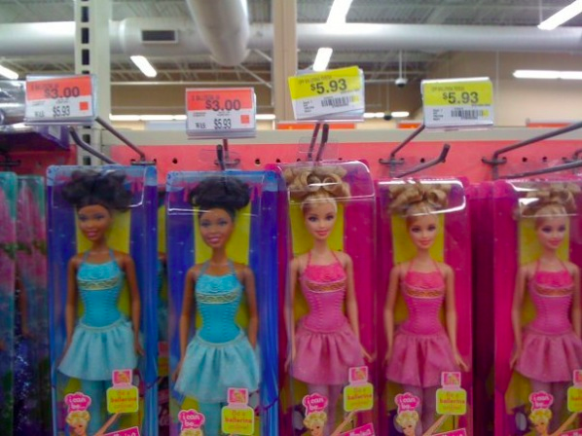
A final note: discrimination

Slide 76
A final note: discrimination
Side-effect of inventory management
Black Barbie sells less often than White Barbie
also nice: https://www.youtube.com/watch?v=t4DT3tQqgRM

Slide 77

More serious – predictive policing Software predicts future criminals, and it’s biased against blacks... by Julia Angwin, Jeff Larson, Surya Mattu and Lauren Kirchner, ProPublica, May 23, 2016

Slide 78
Measuring discrimination
Berkeley discrimination case:
The probability of acceptance:
Pr(admitted | men) = 0.44
Pr(admitted | women) = 0.35
Standard discrimination measure = difference in acceptance probability
Pr(admitted | men) - Pr(admitted | women) = 0.09
 | Applicants | Admitted
Men | 8442 | 44%
Women | 4321 | 35%

Slide 79
Solutions?

Slide 80
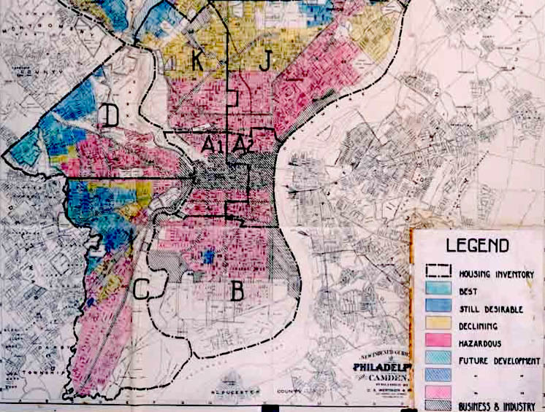
How to avoid discrimination?
Remove/censor sensitive attributes (race, gender, etc.)
Does not work!
Redlining:
Determine sensitive values
from other attributes
Home Owners' Loan Corporation Philadelphia redlining map

Slide 81
First solution: preferential sampling
Randomly draw examples from every sensitive group
From a discriminated group:
Draw more examples with positive labels
Draw less examples with negative labels
From a favored group:
Draw less examples with positive labels
Draw more examples with negative labels
Until a data set is created with 0 discrimination
Maintain the same fraction of positive/negative labels!
Learn a model from this data

Slide 82
Second solution: different thresholds
Learn a probabilistic model
Such a model gives a probability P(i) that example i belongs to the positive class
Naïve Bayes is such a classifier
Use different decision thresholds t for the different sensitive groups, such that
If P(i) > t, then i is labeled as positive
The fraction of examples labeled as positive is roughly equal for every sensitive group

Slide 83
Second solution: different models
Learn a probabilistic model for every sensitive group
Such a model gives a probability P(i) that example i belongs to the positive class
Naïve Bayes is such a classifier
Use different decision thresholds t for the different groups, such that
If P(i) > t, then i is labeled as positive
The fraction of examples labeled as positive is roughly equal for each group

Slide 84
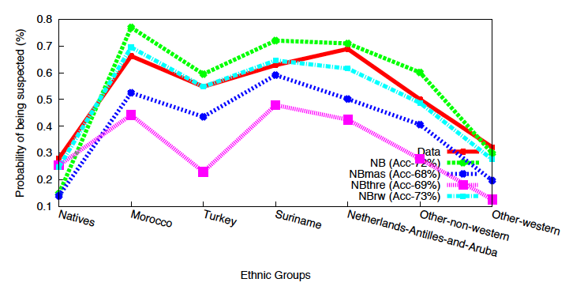
An ethnic profiling study
NB = learning naïve Bayes classifier
NBmas, NBrw = forms of preferential sampling
NBthre = use different models and thresholds

Slide 85
An ethnic profiling study
NB = learning naïve Bayes classifier
NBmas, NBrw = forms of preferential sampling
NBthre = use different models and thresholds
We can reduce discrimination with little accuracy loss

Slide 86
Its not so simple: Simpsons paradox
Berkeley discrimination case, per department:
Seems to favor woman!
Department | Men |  | Women
 | Applicants | Admitted | Applicants | Admitted
A | 825 | 62% | 108 | 82%
B | 560 | 63% | 25 | 68%
C | 325 | 37% | 593 | 34%
D | 417 | 33% | 375 | 35%
E | 191 | 28% | 393 | 24%
F | 373 | 6% | 341 | 7%

Slide 87
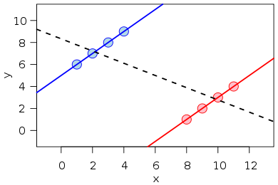
Simpsons paradox
A global trend can be completely reversed when data is split into groups!
There was no discrimination at Berkeley

Slide 88
Some discrimination is OK
When it can be explained using other attributes
e.g., education, experience, salary, etc.
One can use these attributes to split the population into subgroups, discrimination in one subgroup is bad, but between subgroups is OK
Then:
Apply preferential sampling on every subgroup
Ensure that the positive class probability for every subgroup remains the same!

Slide 89
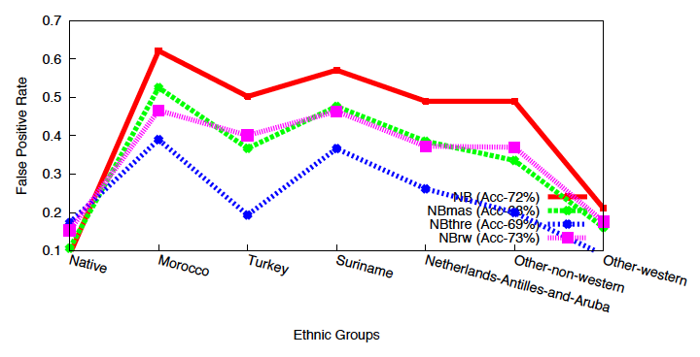
An ethnic profiling case
Native Dutch have 9% probability of being falsely accused by the model, Moroccans 63%...
So please modify the data, algorithm, or output!

